Slide 1

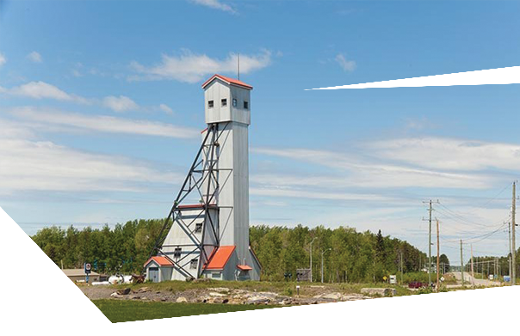





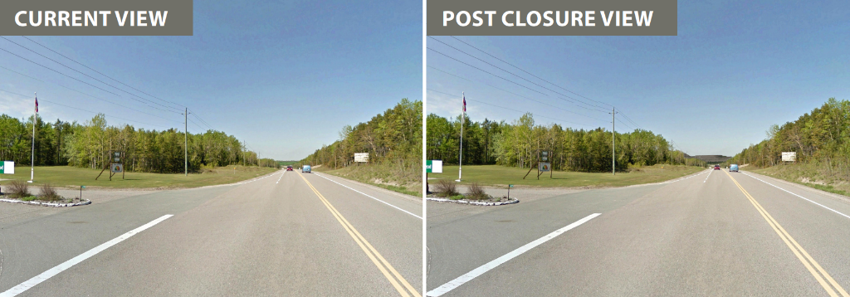

GINOOGAMING FIRST NATION
Session Details
This session will focus on the closure, remediation and reclamation stages of the project. We will have a discussion on all comments, concerns and feedback surrounding the proposed Hardrock Project.
Photo Credit: Greenstone Gold Mines.
ATTEND EACH EVENT FOR MORE CHANCES TO WIN THE GRAND PRIZE DRAWN ON NOVEMBER 7th
SESSION 5:
Closure and Beyond
Tuesday November 7th, 2017
from 5:00 to 8:00pm
LOCATION: GINOOGAMING
TRAINING CENTRE
Feast at 5:00pm
Presentation & Discussion at 6:00pm
GRAND PRIZE at 8:00pm

