Slide 1

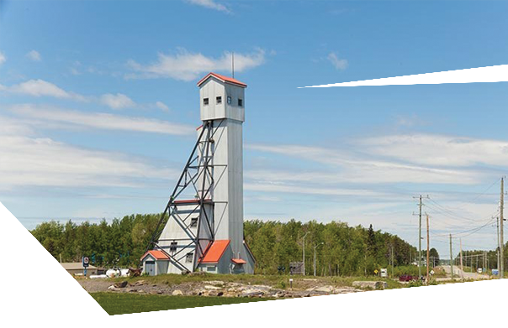





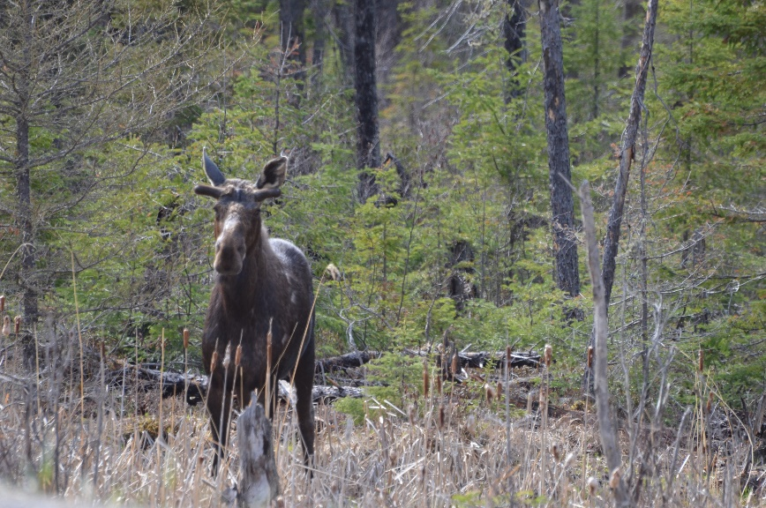
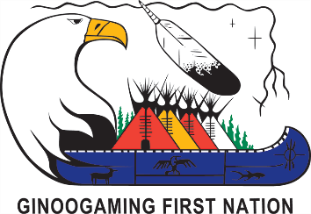
GINOOGAMING FIRST NATION
Session Details
This session will address the potential impacts that mining projects will have on fish populations, wildlife, plants, traditional food sources etc.
Greenstone Gold’s Hardrock Mine and Noront’s Eagle’s Nest Project will be discussed.
ATTEND EACH EVENT FOR MORE CHANCES TO WIN THE GRAND PRIZE DRAWN ON NOVEMBER 7th
SESSION 4:
Fish, Wildlife and Plants
Monday November 6th, 2017
from 5:00 to 8:00pm
LOCATION: GINOOGAMING
TRAINING CENTRE
Feast at 5:00pm
Presentation & Discussion at 6:00pm
Door Prize Draw at 8:00pm

