Slide 1

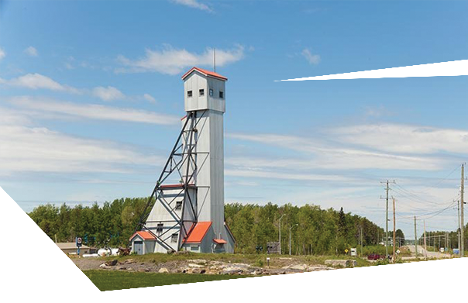





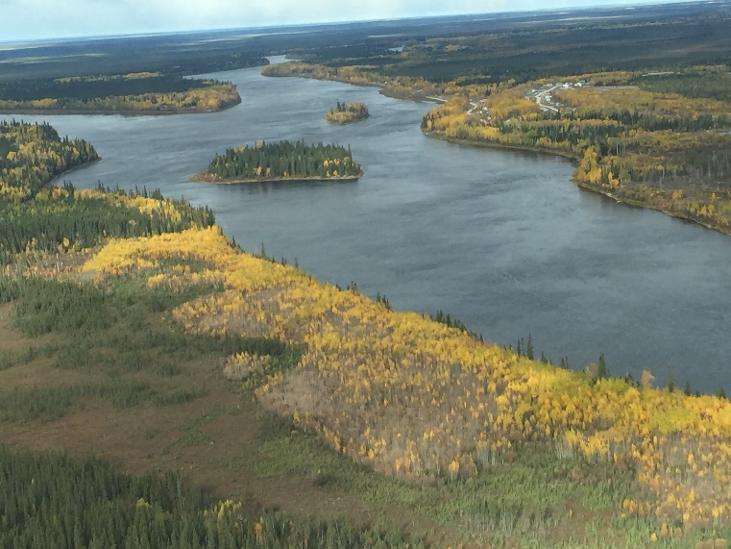
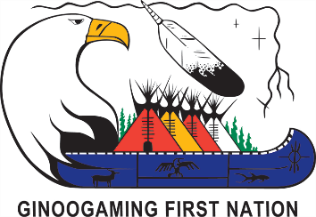
GINOOGAMING FIRST NATION
Session Details
This session will address the waste generated by the mine (waste rock, tailings etc.) and the potential impacts that mining projects will have on the water.
Greenstone Gold’s Hardrock Mine and Noront’s Eagle’s Nest Project will be discussed.
ATTEND EACH EVENT FOR MORE CHANCES TO WIN THE GRAND PRIZE DRAWN ON NOVEMBER 7th
SESSION 3:
Water, Rocks and Waste
Monday October 30th, 2017
from 5:00 to 8:00pm
LOCATION: GINOOGAMING
TRAINING CENTRE
Feast at 5:00pm
Presentation & Discussion at 6:00pm
Door Prize Draw at 8:00pm

