Slide 1
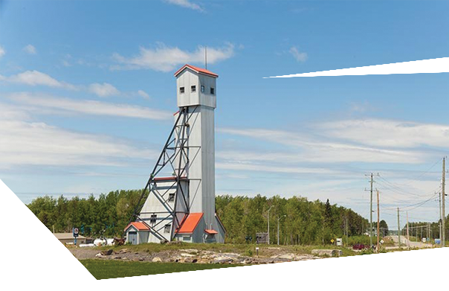
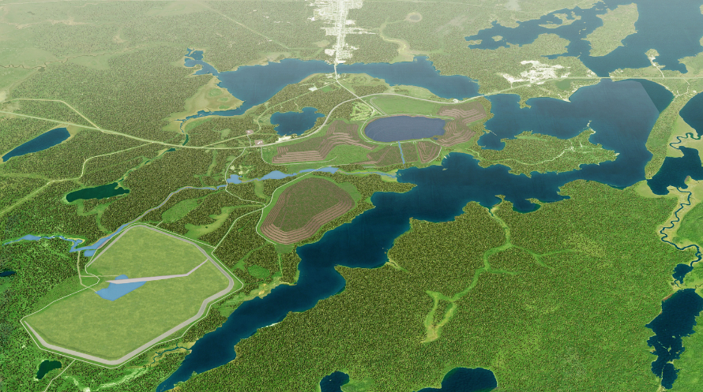
GINOOGAMING FIRST NATION
Session Details
This session will provide an overview of the details of the project plan. What is planned? How is it going to look? How can we expect the landscape in the project area to be impacted?
ATTEND EACH EVENT FOR MORE CHANCES TO WIN THE GRAND PRIZE DRAWN ON NOVEMBER 7th
SESSION 2: The Hardrock Project
Tuesday October 24th, 2017
from 4:00 to 7:00pm
LOCATION: GINOOGAMING
TRAINING CENTRE
BBQ with Greenstone Gold Mine
from 4:00 to 7:00pm

