Slide 1
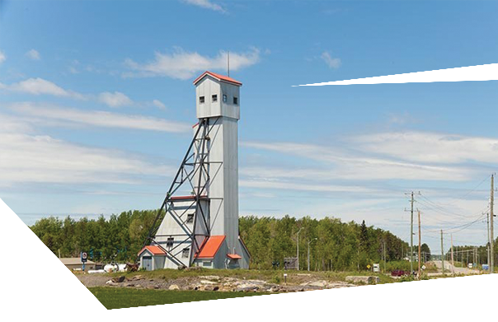
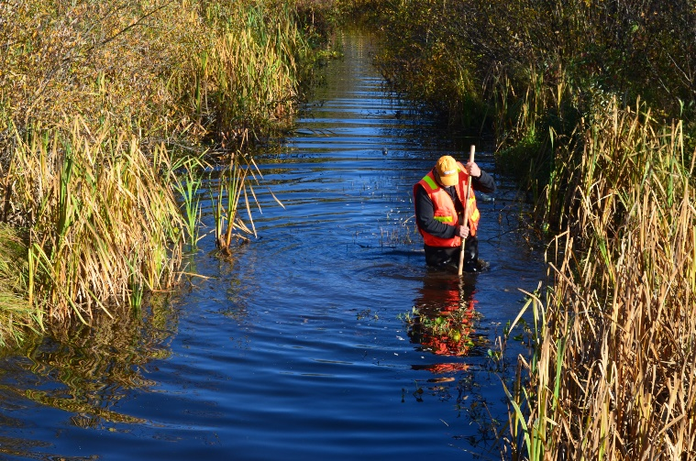
GINOOGAMING FIRST NATION
Session Details
Topics of discussion will include; the plan for the engagement sessions, why it’s important to receive input from the community, what an EA is and what is happening in the region.
Greenstone Gold’s Hardrock Mine and Noront’s Eagle’s Nest Project will be discussed.
ATTEND EACH EVENT FOR MORE CHANCES TO WIN THE GRAND PRIZE DRAWN ON NOVEMBER 7th
SESSION 1: ENVIRONMENTAL ASSESSMENT 101
Monday October 23rd, 2017
from 5:00 to 8:00pm
LOCATION: GINOOGAMING
TRAINING CENTRE
Feast at 5:00pm
Presentation and Discussion 6:00pm
Door Prize Draw at 8:00pm

